Slide 1
Patterns of Effective Test Setup
Assert.That(yourTests.suck)
Assert.That(yourTests.canGetBetter)
@spetryjohnson

Slide 2
Are you in the right place?
Not "testing 101"; assumes prior experience
Not about mocking / stubbing / testable code
Not about specific framework or language
All about improving setup of test data

Slide 3
Why care about test setup?

Slide 4
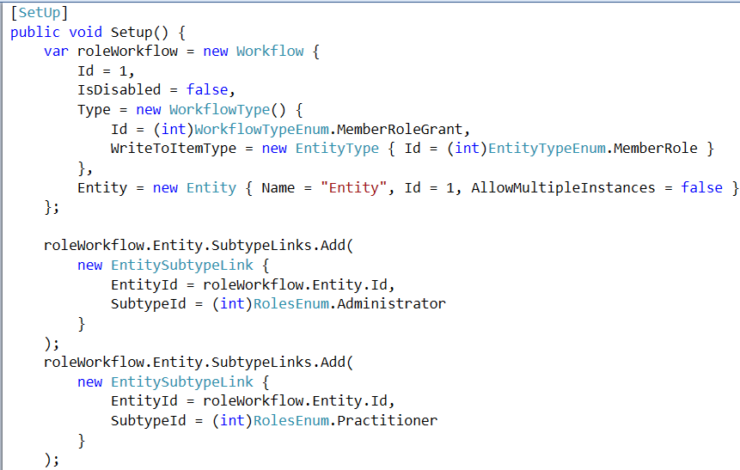
Behold, the reason we’re here
Notes:
Minute ago said I hated seeing people SKIP tests because they would be hard to write
That’s only half the reason I wrote this talk – other half is seeing really convoluted setup code in the tests that DO get written
Here’s an example – needed to make minor adjustment to a feature
Feature itself was complex, but the new change was simple – should not take a lot of time
Before writing any new code, wanted to learn more about how the feature currently worked and wanted to write a failing test
CLICK: So I opened up the file containing the existing tests, and my heart sank when I saw this: <PAUSE>

Slide 5
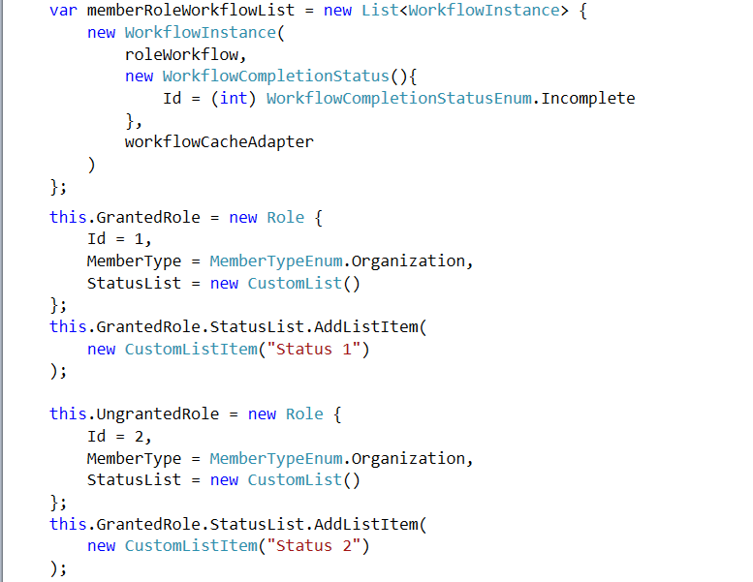
Notes:
... And this …

Slide 6
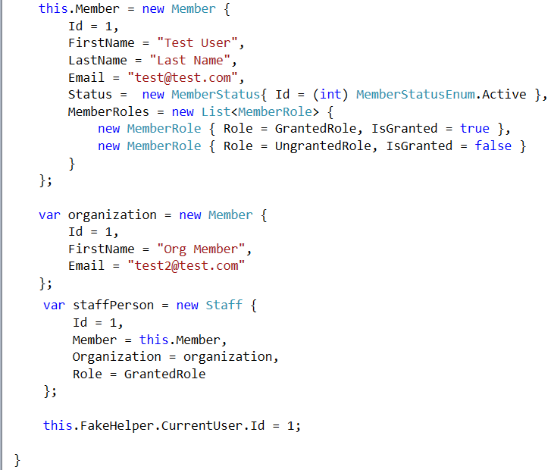
Notes:
… and this.

Slide 7
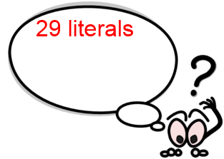
Notes:
That’s 29 string, integer and Boolean values being initialized….

Slide 8
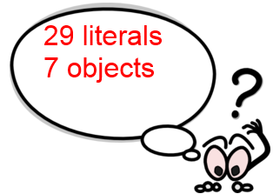
Notes:
… 7 objects being created…

Slide 9
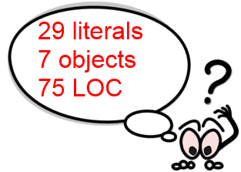
Notes:
… and 75 lines of code to understand.

Slide 10

Notes:
This is just the SHARED setup code for the test suite. Individual tests had more code like this, and all depended on different portions of this mess.
Became clear that even though my change was simple, understanding and modifying tests would not be
Went back to team – increased estimate – spent more time than should have been necessary
Not an isolated case – thousands of tests in our projects
Countless hours spent reading those tests and trying to make sense of stuff like this
TRANSITION: This sucks. Fortunately, it doesn’t have to be this way.

Slide 11
What’s on the agenda?
4 mistakes you're making today
4 keys to success for unit test setup
Advanced tips and tricks for integration tests

Slide 12
What is “test setup”, exactly?
Code written outside individual tests ( “fixture” setup)
Code written inside individual tests
Anything that creates test data in memory or db

Slide 13
Test Setup Mistake #1 It's easier to describe scenarios in words than code
Notes:
If the first step in getting better is to admit that you have a problem, then the first step in writing better setup code is to recognize 4 mistakes you’re making today and why they’re so harmful.
The first mistake is allowing your project to get to the point where it is significantly easier to describe business conditions in words than in code.
For example, in my main app, one of our core domain concepts is a thing called a “workflow”. There are very few things that a user can do that don’t involve a workflow in one way or another, which means that many of our requirements deal with workflows in different states.

Slide 14
Mistake #1: Hard to create common states
TODO: Image of simple business case exploding into multiple lines of code
Notes:
It’s pretty simple for an analyst to say something like “When a workflow is <configured like this> then the system <should do that>”. In practice, though, actually creating a workflow in that state is complex; a workflow is composed of lots of smaller objects that work together, and they have to be set up in a logically consistent way to represent real-world code paths and to avoid runtime errors.
When it’s much easier to describe a scenario in words than in code, you end up with the setup nightmare I showed you a few slides ago. And if you can’t easily put your software into common states for testing purposes, then you’re either going to pull your hair out when you write tests, or you’re going to stop writing them.

Slide 15
Test Setup Mistake #2 Manually constructing dependencies
Notes:
The second mistake people make when setting up tests is constructing all of your object dependencies by hand.
In almost every system there are tests that only care about a portion of an object. A test about an Order’s SHIPPING STATUS may not care about its line items, or a test about a Customer’s ADDRESS may not care about their name.
But it’s not always possible to create objects and specify ONLY what you care about. In C# for example the object’s constructor may require things that are necessary to the domain model, but don’t actually matter to that specific test

Slide 16
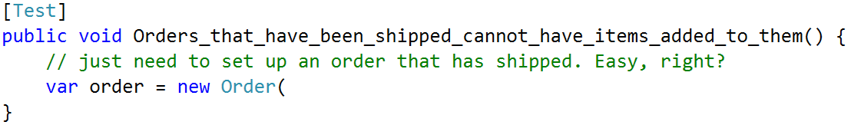
Mistake #2: Manually constructing objects

Slide 17
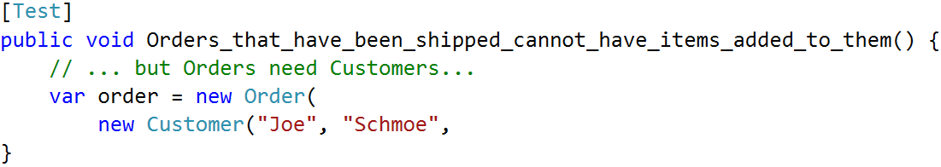
Mistake #2: Manually constructing objects
Notes:
But apparently an Order object needs a Customer…

Slide 18
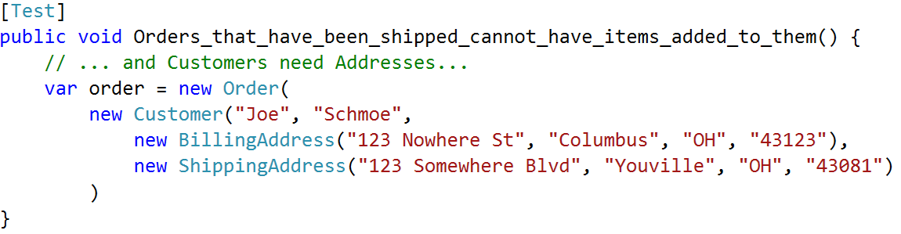
Mistake #2: Manually constructing objects
Notes:
… and a Customer needs some Addressess…

Slide 19
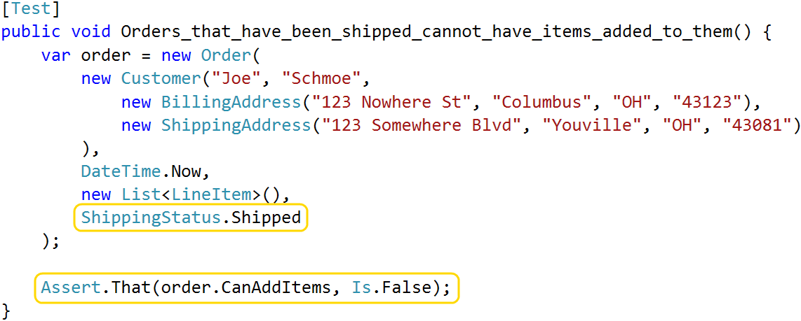
Mistake #2: Manually constructing objects
Notes:
… and by the time I’ve satisfied the constructor, I’ve written a whole lot of code when I really only care about two things: the order’s shipping status, and whether or not it accepts new items.

Slide 20
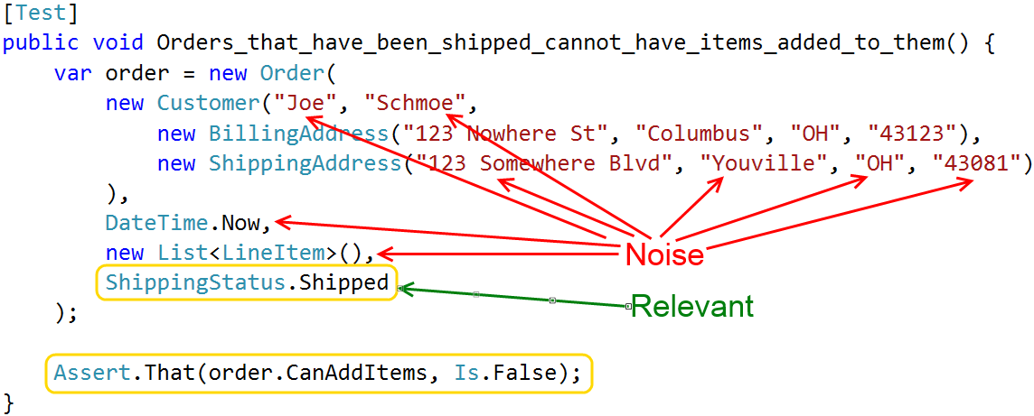
Mistake #2: Manually constructing objects
Notes:
All of these things that I created, but that don’t actually influence the assertion I’m making, are noise. Writing a test like this is painful, but it’s also painful to read these tests. You have to work hard to filter the signal from the noise so that you can understand it.
Some objects that I deal with have 4, 5 or even 6 layers of composition. Object A uses B, B uses C, etc. If we had to deal with this for every single test, we would be writing way fewer tests. It would make me crazy to do this every day.

Slide 21
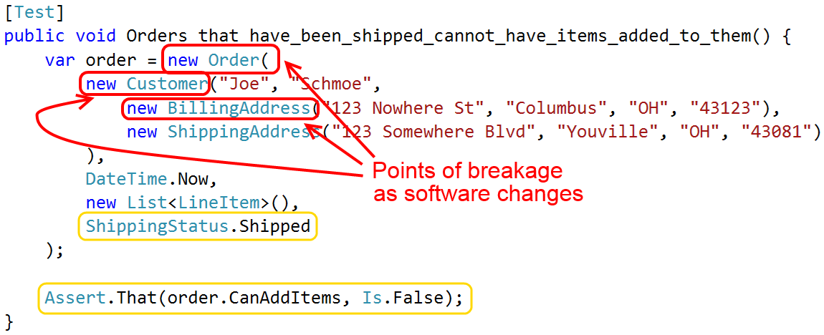
Mistake #2: Manually constructing objects
Notes:
This mistake can also make your test code brittle.
What happens when the Order, Customer or Address constructors get modified?
If you’ve ever made a simple change to your application, and then spent the next two hours cleaning up failing tests, you’ve felt this pain.

Slide 22
Test Setup Mistake #3 Noise values obscure meaningful ones
Notes:
The third setup mistake is specifying a lot of explicit values in your setup code, when those values don’t actually impact the outcome of the test.
Imagine that you have code that fails if the Customer email address is null, or if some integer field is left at its default of 0. When setting up a test that executes that code path, even if it’s really central to the test itself, you have to initialize those properties to avoid those failures. Those values that you set, which DO NOT MATTER to the test, are impossible to distinguish from other values that DO matter to the test.

Slide 23
Mistake #3: Too many "noise" values
TODO: Screenshots for lots of primitives
Notes:
When other programmers read your code, they have to spend time figuring out which values are part of the test scenario and which are arbitrary. Does this assertion only apply to customers that are in the “PasswordReset” state? Or does it apply to all customers?
And if you’re writing shared setup code, it can be hard to identify which values can be changed without impacting other tests using the shared setup.

Slide 24
Test Setup Mistake #4 Reusing setup code via inheritance

Slide 25
Mistake #4: Using inheritance for reuse
TODO: Image for inheritance
Notes:
TODO: Image for inheritance
A quick and easy way of doing that would be to create a base class that does the setup and then derive multiple fixture classes from it.
There are two problems with this. First, inheritance is a very restrictive way of achieving reuse. In C# you can only have a single base class, and there’s just no good argument for requiring that your Customer tests and your Order tests derive from the same base.
Secondly, as your system evolves over time, the needs of your tests might start to diverge. Maybe there’s one specific Customer test that needs to specify a distinct email address, or an Order test that requires that the Order not have any line items.
If the setup code is in the base class, it’s really difficult to manage those test-specific changes. You end up doing things like replacing or overriding parts of the shared data in the body of each test, but that’s ugly and error prone.
To properly reuse setup logic we need to get it out of a base class and into something more easily managed. I’ll show you what that looks like in a moment.

Slide 26
There is a better way!

Slide 27
Key Practice #1 Stop creating data by hand!
Notes:
The first key to success, and the single most important thing you can do to improve your setup code, is to stop constructing test objects by hand. Instead, push object creation into some sort of helper method or object.
This gives you two benefits:
It often shortens your setup code, making it easier to write and maintain
It increases resiliency; if an object’s constructor changes, you potentially only need to update the helper method.
There are a couple of established patterns for handling object creation.

Slide 28
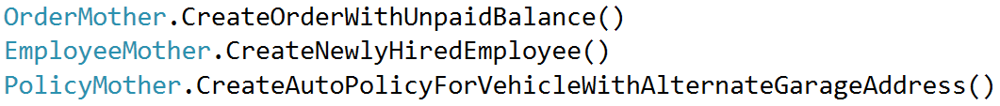
Key #1: Stop creating data by hand!
Object Mother
Notes:
The first pattern that we tried is called Object Mother. The key idea behind this pattern is that you identify up front the different test data that you’ll need, and then you create static factory methods for each of those pre-defined states. For example, the “Order Mother” object might have a factory method for creating an order with an unpaid balance, or if you work with insurance, the “Policy Mother” object might create an insurance policy object with a specific combination of coverages.
Object Mother is a great way to get all of those noise values and objects out of your setup code, but it doesn’t really scale that well. As your software gets more complex you’ll need more and more pre-built objects in more and more pre-defined states. And as the number of pre-built objects and states grows it becomes harder to maintain them and harder for developers to choose between them.

Slide 29
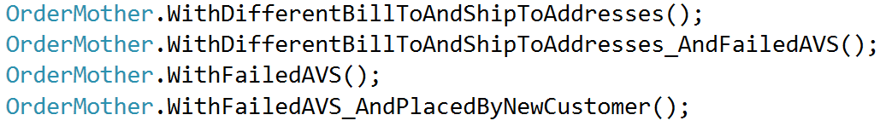
Key #1: Stop creating data by hand!
Object Mother
Notes:
Eventually, you end up with a mess like this. There’s one method for creating an order with different bill-to and ship-to addresses. There’s one for indicating that the credit card failed address verification. There’s one for specifying that the order was placed by a new customer.
There’s a ton of overlap here. What happens when someone needs an order that was placed by a new customer, and had failed the AVS checks, and had different bill-to and ship-to addresses? That exact scenario isn’t covered by any of these, so that developer would probably end up creating yet another method for their exact need. And that new method would probably have a lot of duplication when compared against the ones that already exist.
Object Mother is a really easy pattern to implement if you only need a couple of course-grained pre-built objects. We needed a lot more control over our test data, so we quickly outgrew this pattern.

Slide 30
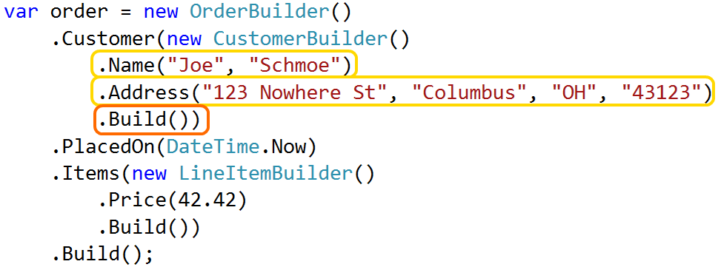
Key #1: Stop creating data by hand!
Data Builder
Notes:
The next thing we tried was a pattern called Data Builder.
Rather than a factory that returns pre-built objects, Data Builder lets you create customized objects in the body of each test. It’s common for this to be accomplished via a Fluent API that exposes the things that can be customized.
The general structure in this pattern is that initialize the builder itself and then start calling methods to customize various parts of the object. Those methods are chained together and at the very end you call a Build() method which returns your fully built object.
These can be very simple, or they can get pretty complex as you see here where we’re creating both an Order and Customer with customized properties.
The main benefit of the Builder pattern is flexibility because it lets you can create the precise data that you need for each test, and that makes it a much better fit for larger or more complex applications.

Slide 31
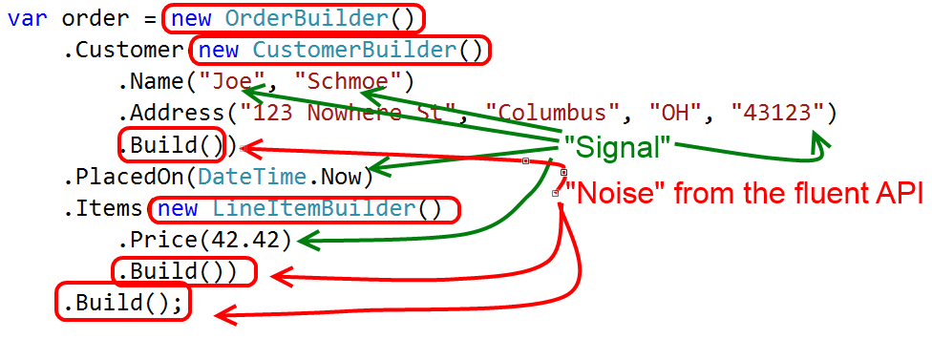
Key #1: Stop creating data by hand!
Data Builder
Notes:
However, I’m really not a big fan of the Fluent API. It’s verbose and adds a lot of noise, as you see here. The green arrows are pointing to the significant data that I’m creating and the red circles are basically the “noise” that we get from the fluent API.
All this noise code means that the setup code is harder to write, read, and maintain. And on top of that, actually implementing the Fluent API is tedious. It requires a lot of boilerplate code that in my experience just isn’t worth the hassle.

Slide 32
Key #1: Stop creating data by hand!
Test Helper
(Static Methods) + (Customization) – (Fluent API)
Notes:
TODO: graphic
Eventually, we created a hybrid of these two patterns that combines the static factory class of Object Mother with the customizable nature of a Data Builder, minus the Fluent API.
We call this the Test Helper pattern. It’s a terrible name, but it’s been a really useful pattern for us and I think it’s highly applicable not only in C# but also in JavaScript or Ruby.

Slide 33
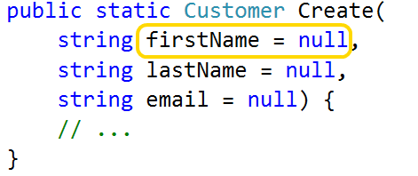
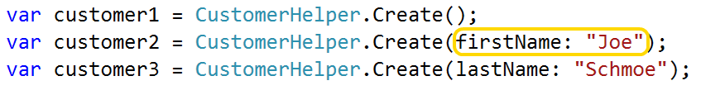
Key #1: Stop creating data by hand!
Test Helper
Notes:
TODO: Version of this without the defaults
The first step in implementing a Test Helper is to create a static factory method like Object Method, but give it a generic name like “Create” and expose all of the data that you want to customize as method arguments.
This gives us a flexible, extensible mechanism for creating data that’s specific to each test, without all the overhead of that fluent API.

Slide 34
Key Practice #2 Explicitly specify only the values that matter
Notes:
The second key to success is to make your tests as expressive and as readable as possible by specifying only the data that is significant to the test outcome.
Like I mentioned earlier, when someone is reading your tests and they see a string or integer literal, they have to figure out whether that specific value is relevant or not. The goal of any good test is to communicate how the system will behave given a specific set of inputs. But your tests can’t effectively communicate in that way if they’re full of noise values that dilute that message.

Slide 35
Key #2: Specify only significant values
Liberal use of defaults
Notes:
If your language supports the concept of “optional parameters” then our Test Helper pattern is easily adapted to follow this guideline.
Basically, you just take the static factory method and you specify default values for just about everything.
Then when you call the method, you only specify those specific values that you care about.

Slide 36
Key #2: Specify only significant values
Liberal use of defaults
Notes:
TODO: Behind the scenes image
Behind the scenes, the helper itself is responsible for assigning default values to anything that wasn’t otherwise specified.
For primitive properties I generally make all of the arguments nullable. You could specify an actual value in the default, but sometimes it’s helpful to know whether or not the caller provided a value. You can do that will null, but not if your arguments are given a default value in the argument declaration.

Slide 37
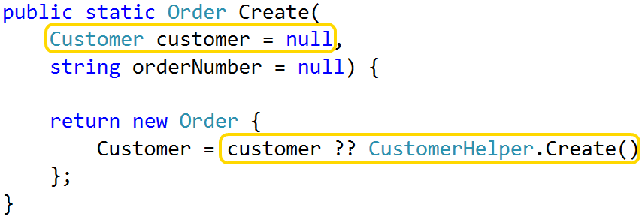
Key #2: Specify only significant values
Delegate to other helpers as needed
Notes:
If you’re building an entire object graph, you can expose children or dependencies as arguments as well. If the caller leaves them null, just delegate to the relevant helper to create them. This approach keeps each helper focused on a single object type while still supporting very rich and complex compositions.

Slide 38
Key #2: Specify only significant values
Avoid "unexpected equality"
Notes:
TODO: Code sample showing flawed test
There’s one potential gotcha with this approach. You should be very careful when creating objects with hardcoded values as their defaults. This can lead to something I call “unexpected equality”.
For example, let’s say you create two different Customers from the helper, you pass them into some method, and finally you assert that the method returned a result with an email address equal to customer #1.
The assumption here is that the test will fail if the code returns the email of customer #2. But if the CustomerHelper object sets a default email address of NULL, or some hardcoded static value, then this test will pass even if the logic is faulty. This is what I mean by “unexpected equality”.
By default, I prefer to make all values unique. I want to force programmers to be explicit if they want things to be equal.

Slide 39
Key #2: Specify only significant values
Avoid "unexpected equality": ShortGuid
bit.ly/1dCxSbe
Notes:
Todo: code
One thing that makes it easy to assign unique values is a class called ShortGuid. This is basically a shorter, URL-friendly, base64-encoded GUID, and you can get the code from this link.
Whenever I’m creating a name or a title or something, I use a ShortGuid as the default. It guarantees that no two objects I create will share the same value, unless I explicitly set them up that way.

Slide 40
Key #2: Specify only significant values
Avoid "unexpected equality": IdSequencer
bit.ly/1d7zHz7
Notes:
Todo: code
This issue of unexpected equality also applies to integer values. For instance, if I create two customers from the customer helper, I wouldn’t expect them to have the same ID value unless I explicitly assign it that way. So how do we assign a unique ID to each integer?
I created a static class called the IdSequencer. It basically starts a counter and hands out a unique value each time I call “next”. Any time I have a helper that creates something with an ID property, I expose the ID as an argument and then I default it using the sequencer.
This technique is actually really, really helpful if you want to use these helpers for integration tests too. You’ll see that in a few minutes.

Slide 41
Key Practice #3 Create "scenario" objects for reusable setup logic

Slide 42
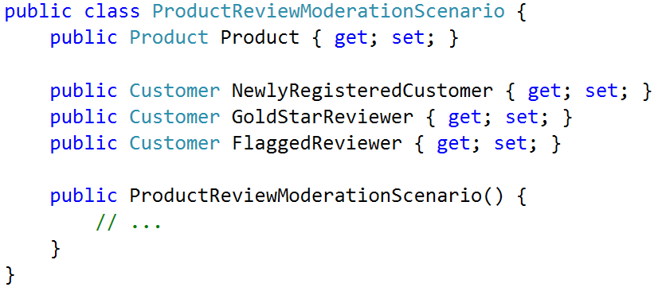
Patterns & Practices – Scenarios
Expose key data as instance properties
Notes:
Biggest difference between Scenario & Test Helper – static factory vs instance
Key objects or relationships are exposed as instance properties of the Scenario

Slide 43
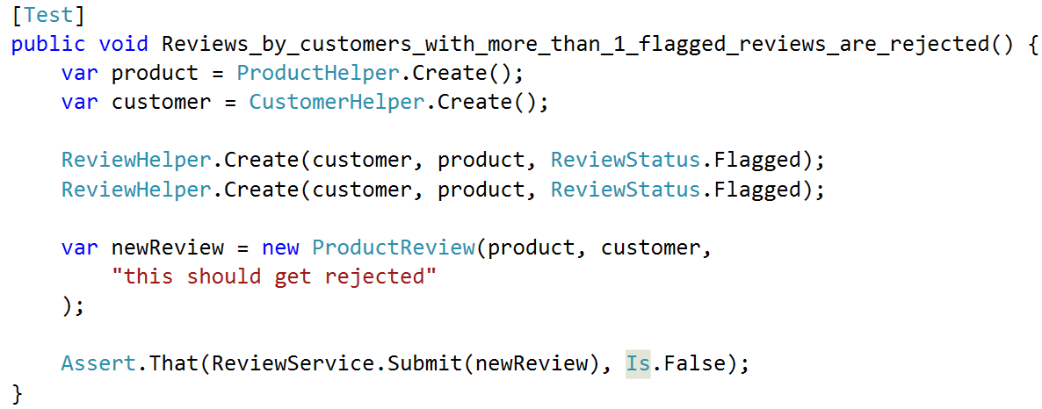
Patterns & Practices – Scenarios
Which is more expressive?
Notes:
Here’s an example of why this is useful.
This test does NOT use a scenario
Asserts that customers cannot submit new reviews once they’ve been flagged for objectionable content
Test creates a product and a customer, then 2 flagged reviews
Finally, tries to submit a new review & asserts it is rejected
Certainly not a terrible test - could be better

Slide 44
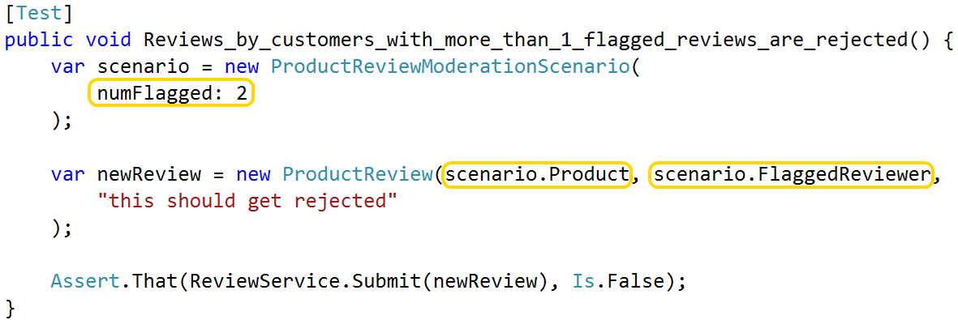
Patterns & Practices – Scenarios
Which is more expressive?
Notes:
Here’s the same test, re-written with a Scenario
Notice that I’m instantiating the scenario object & passing data to the constructor
Notice how much less noisy it is, without the customer and product objects
Scenario exposes references to them
Replaced the explicit creation of two flagged reviews with a single declarative argument
To repeat this test with a different # of flagged reviews, copy 1 line of code & change 1 argument
Excellent example of how expressive setup code makes it easy to add new tests

Slide 45
Key Practice #4 Tell a story with your setup code

Slide 46
Using Test Helpers for integration tests

Slide 47
"Doing it right" – 4 keys to success
Stop creating objects by hand!
Specify only what matters
Tell a story
Use scenarios for complex setup

Slide 48
DIVIDER LINE
Notes:
Tests that are hard to write don't get written.
So how do we write tests that don’t suck up all our time, money and energy?
Start by identifying core principles of good setup code
Highly expressive – delve into what that means in a moment
Highlights what really matters
Avoids inheritance for data reuse
Resilient - Doesn’t need constant upkeep as software changes
TRANSITION: Let’s look at those in more detail.

Slide 49
Patterns & Practices – Test Helpers
Assign unique values – avoid “unexpected equality”
Notes:
First, try to avoid creating objects that have properties equal to null or hardcoded values
Null can lead to errors
Hardcoded values can lead to “unexpected equality”
Example: create two Customers from the helper, then compare their email address. Should they be equal?
Too many tests fail that should have passed, or vice versa, because of this unexpected equality
By default, MAKE THINGS UNIQUE – force callers to be explicit if they want things to be equal

Slide 50
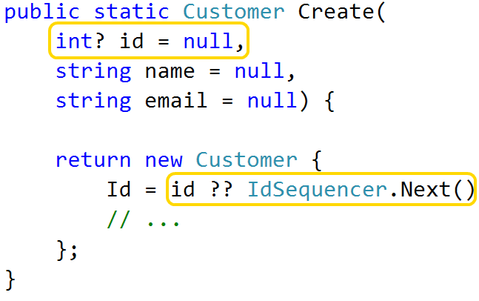
Patterns & Practices – Test Helpers
Assign unique values – avoid “unexpected equality”
ShortGuid for short, unique strings (bit.ly/1dCxSbe)
IdSequencer for unique integers (bit.ly/1d7zHz7)
Notes:
To create unique integers, I use a class I call the IdSequencer
Every time you call Next() it returns a new value
If we have time I’ll show you how it works – or hit the bit.ly link
I always assign unique integers to Id fields – callers can explicitly set up differently if they need to
I may or may not assign unique integers to other fields, it depends on what they are.

Slide 51
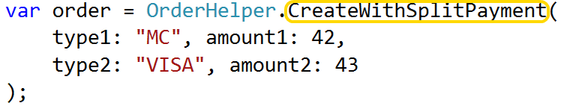
Patterns & Practices – Test Helpers
Can act like an Object Mother, too
Notes:
Generally speaking, helpers have a single method called Create()
Creates as generic an object as possible
Whole point is that caller specifies what it cares about
In some cases, create specialized helpers like an Object Mother
Consider if you notice patterns in your setup code
For instance, same set of parameters being set at same time
This example shows a helper that creates an Order with multiple payment types.
Less code than calling standard Create() method w/ lots of arguments
Easier to refactor related tests
Do this sparingly – same drawbacks as Object Mother
Transition:
After some experimentation, my team has settled on Test Helpers as our go-to pattern
Flexible, easy to implement, and easy to extend for integration tests
We’ll come back to that in a bit

Slide 52
"Doing it right" – 4 keys to success
Short; clearly establishes baseline state
Notes:
The first principle is that tests should be “highly expressive”. What does that mean?
Dictionary defines “expressive” as “effectively conveying thought or meaning”
Setup code should clearly convey the scenario that’s being created and why
We can’t understand the assertions unless we understand the context too
Important that readers can come to that understanding quickly
Thousands of tests –read every day - Don’t waste time
Easy to look at similar tests and spot what’s different
CLICK: Here’s an example. Quick, what’s the point of this code?
Hard for me to tell too

Slide 53
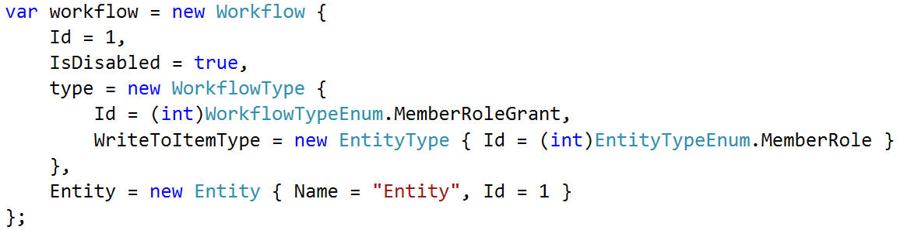
Good setup code is highly expressive
Short; clearly establishes baseline state
High “signal-to-noise ratio”
Quickly skim the code / spot differences in similar tests
Notes:
The first principle is that tests should be “highly expressive”. What does that mean?
Dictionary defines “expressive” as “effectively conveying thought or meaning”
Setup code should clearly convey the scenario that’s being created and why
We can’t understand the assertions unless we understand the context too
Important that readers can come to that understanding quickly
Thousands of tests –read every day - Don’t waste time
Easy to look at similar tests and spot what’s different
CLICK: Here’s an example. Quick, what’s the point of this code?
Hard for me to tell too

Slide 54
Good setup code is highly expressive
Short; clearly establishes baseline state
High “signal-to-noise ratio”
Quickly skim the code / spot differences in similar tests
Notes:
How about this?
Does same thing - removed all the extraneous noise
This is the sort of readability I’m talking about

Slide 55
Good setup code is highly expressive
Entire test should fit on screen w/out scrolling
Notes:
Another way to write expressive code is to write LESS of it
General rule of thumb - avoid writing tests that require more than 1 screen of code
Purpose of this constraint - hyper-focused on the clarity of my setup code.
If can’t describe the test data in just a few statements - writing that code at too low a level.
Like refactoring a method into smaller and smaller pieces: just keep asking yourself, can I describe this with fewer code?
I’ll show you some techniques in a few minutes that help me meet this goal more often than not.

Slide 56
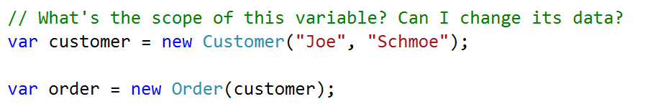
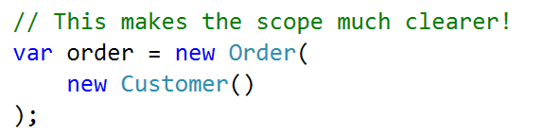
Good setup code is highly expressive
Use scoping rules to eliminate intermediate objs
Notes:
Sometimes need to create one object only to create something else.
Example: need a Customer to create an Order
Two statements, one meaningful operation [create the Order]
Not immediately clear if the Customer is reused elsewhere. Is it safe to change?
Is the customer data part of the core essence of the test? Or is it noise?
CLICK: 2nd image:
Moving instantiation of Customer inside the Order constructor - express 1 meaningful operation as 1 code statement.
Avoiding intermediate objects improves clarity

Slide 57

Good setup code is highly expressive
Make clear why you’re doing what you’re doing
Notes:
Making it easier to understand WHAT is only half the battle
Good setup code communicates WHY
Computer doesn’t care about your motivations
Co-workers, and future you, DO care
Don’t make them guess!

Slide 58
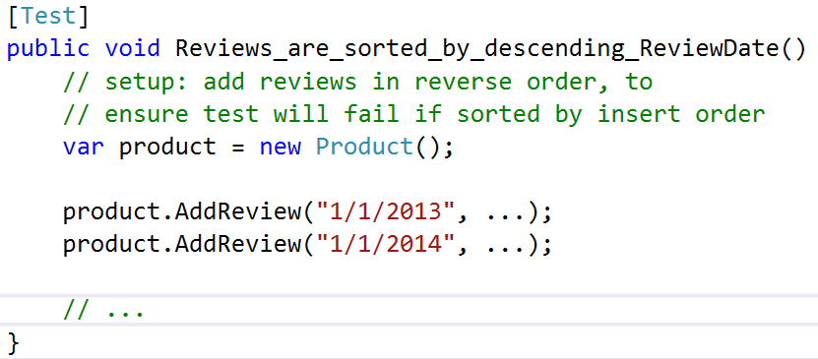
Good setup code is highly expressive
Make clear why you’re doing what you’re doing
Notes:
Example: Test asserts that product reviews are sorted in a specific way
Setup intentionally adds data in reverse order than it should be output
This arrangement is crucial – if we insert data in sorted order, how do we know the sorting code works?
Comment draws attention to this significance
Different rules about comments in test code than production
Production code strives to make comments unnecessary – extract method
Less likely to extract small, one-off methods in test code
Clutters the files
Hard to manage at scale
If setup code needs more than 1- or 2-line comment, extract to helper

Slide 59
Good setup code highlights what matters…
Notes:
This next principle is that “good setup code highlights what matters and downplays what doesn’t”.
Goal is to clearly differentiate data that impact the test and data that don’t
Easier for programmers to read and maintain tests

Slide 60
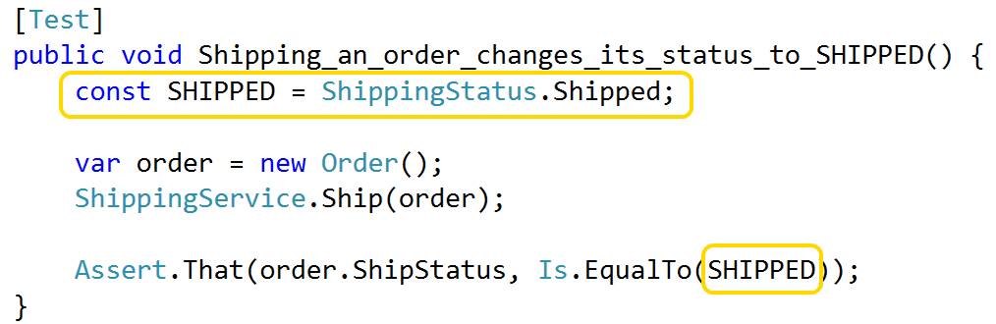
Good setup code highlights what matters…
Named constants for important values
Notes:
Replace key values with named constants
Three benefits:
Draw attention to them and visually reinforces their importance
Makes the code read more like English
Makes it easier to spot differences between otherwise similar tests.
TRANSITION:
In this example, name communicates its value
Even more effective when name communicates its purpose in the test

Slide 61
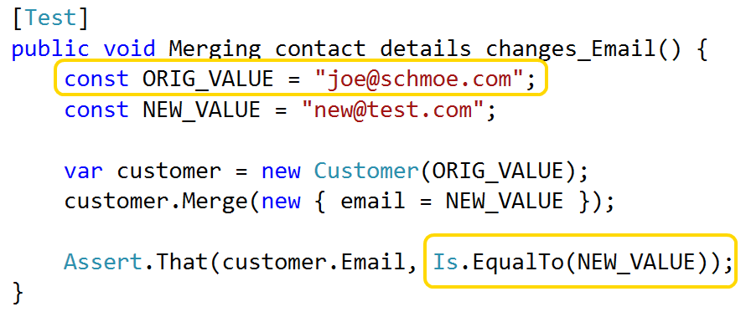
Good setup code highlights what matters…
Named constants for important values
Notes:
In this example, the actual value is irrelevant
Note how the names of “original value” and “new value” give extra clarity to the assertion
Pause
Transition: Of course, giving things good names applies everywhere, not just to constants.

Slide 62
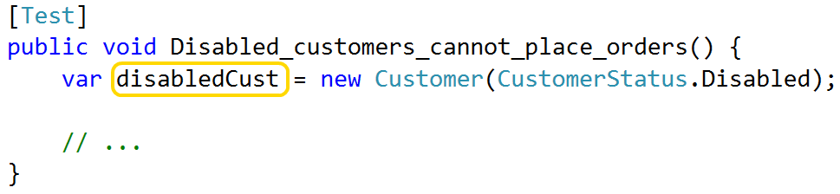
Good setup code highlights what matters…
Give data objects descriptive names
Notes:
Just like in production code, give test objects names that communicate their purpose
If your test revolves around the fact that a Customer is disabled, call it “disabled customer”

Slide 63
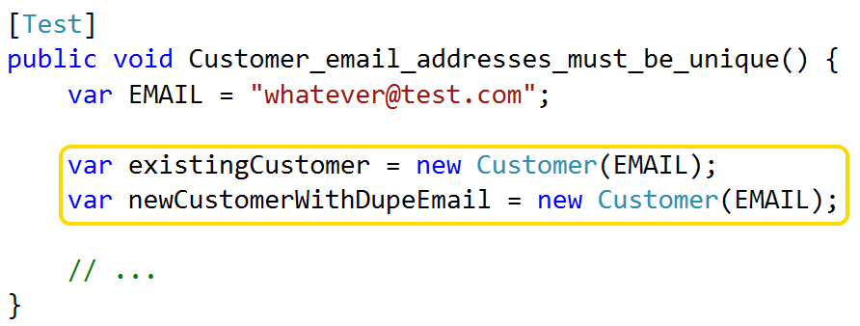
Good setup code highlights what matters…
Give data objects descriptive names
Notes:
If contains multiple objects of same time, use names to differentiate them
Sounds obvious, but if I had a nickel for every time “customer 1” and “customer 2”….
I’d have a lot of nickels.
Tests should tell a story – easier to understand when actors have meaningful names.
Doesn’t take a lot of effort
Makes a big difference
I hate coinage, don’t need any more nickels
Transition:
Important that meaningful data stands out
Also important to downplay data that isn’t as meaningful

Slide 64
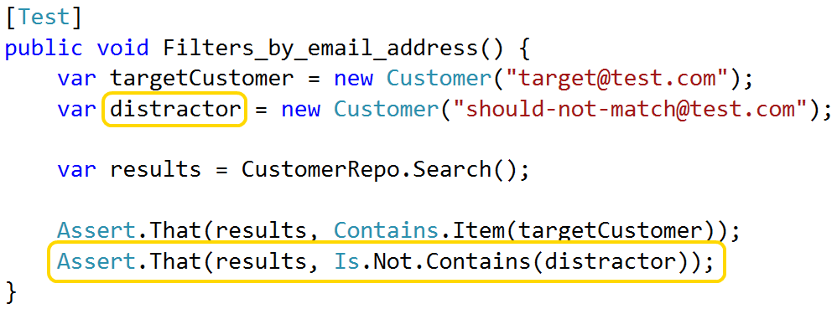
… and downplays what doesn’t
Give data objects descriptive names
Notes:
Common example where this is useful
When writing tests for search or filter, important to do positive AND negative test
Just as important that code returns the things it should as does NOT return what it shouldn’t
My convention is to use the term “distractor” when naming the objects that shouldn’t get returned
Communicates object is not important, as long as its different from the target
Use that name consistently, co-workers immediately recognize the point of these objects
This sort of instant pattern recognition is another key benefit of expressive code

Slide 65
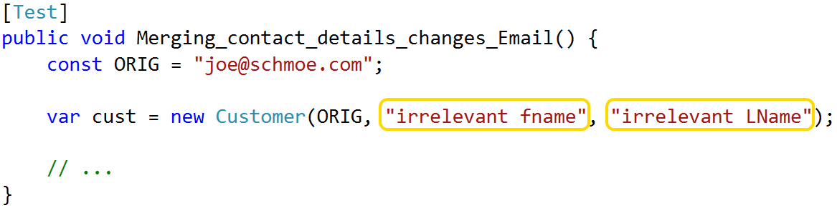
… and downplays what doesn’t
Consistent use of “dummy” values
42, “irrelevant”, etc
Don’t use defaults like null and zero; avoid “unexpected equality”
Notes:
Another way to downplay is w/ consistent dummy values
Example: constructor takes 3 arguments, I only care about 1
Passing null might cause errors
Use value that is obviously irrelevant
Try to avoid numbers like 0, 1, and 2
Frequently appear as meaningful values
Want arbitrary values to stand out – I use “42” as my dummy integer
You can use whatever you want – just be consistent

Slide 66
Good setup code avoids inheritance
Base classes should not construct data
Hard to tweak data for each test
Notes:
The third principle of good setup code is to avoid inheritance, at least for the purposes of creating test data.
CLICK
The first reason is that inheritance makes it hard to tweak shared data for each test
Imagine you have 5 tests covering the same piece of code
Setup for these tests will be very similar
For sake of example, lets’s say that any 2 tests will have 90% of same setup needs
Different tests have different 90% in common
One might need to change an Order’s ship status, another might need to change a Customer’s name
This can be handled w/ inheritance – not clean, not elegant

Slide 67
Good setup code avoids inheritance
Base classes should not construct data
Hard to tweak data for each test
No re-use in other tests
Notes:
Inheritance also limits ability to re-use setup logic.
Assume generic setup, like linked Customer, Order and Line Item.
Useful when testing any of those objects
Don’t want to force inheritance hierarchy
To re-use setup logic, we need to get it out of the base class & into something more easily shared
In a few minutes, I’ll show a clean and elegant technique for doing this without inheritance

Slide 68
Good setup code avoids inheritance
Base classes should not construct data
Hard to tweak data for each test
No re-use in other tests
Base classes can set up infrastructure…
… and initialize shared services
… and stub out behavior orthogonal to the test
… but they should avoid creating data.
Notes:
Base classes can initialize shared services or stub out certain types of behavior
Just avoid creating data

Slide 69
Good setup code is resilient to change
Trivial changes != mountains of errors
Notes:
4th principle of good setup code is that it is resilient to changes in the main app
Tests should be adding value
Not subtracting it by demanding constant attention

Slide 70
Good setup code is resilient to change
Trivial changes != mountains of errors
Minimal effort to refactor tests
Notes:
In the same vein, we want to be able to easily refactor our test projects
Seen people be sloppier in test code than real code – that’s a mistake
Important to keep tests malleable

Slide 71
Patterns & Practices – Scenarios
A façade for invoking multiple Test Helpers
Use when objects have relationships you care about
Notes:
Test Helpers are great at returning single object - track of multiple objects AND their relationships?
Example: product review feature - one or more Products, one or more Customers w/ Reviews for those products, etc
Wiring up by hand is tedious & sacrifices expressiveness
CLICK
We’ve created a pattern we call a “Scenario”
Essentially a façade that simplifies the usage of multiple Test Helpers towards a common goal
Provides a convenient way of tracking relationships between test data

Slide 72
Patterns & Practices – Scenarios
A façade for invoking multiple Test Helpers
Most useful when objects have complex relationships
Reuse complex arrangements w/out inheritance
Notes:
Changes are:
If your feature requires complicated setup, you’re going to have multiple tests
If you have multiple tests for the same feature, you’ll probably want to re-use setup code
Specifically designed for reuse
Transition: So what does a Scenario object look like?

Slide 73
Patterns & Practices – Scenarios
Same drawbacks as Object Mother
Painful when tests need to customize data
Hard to change once many tests use it
Notes:
Not perfect
Same drawbacks as Object Mother – Scenario is basically a Mother for a group of objects

Slide 74
Patterns & Practices – Scenarios
Same drawbacks as Object Mother
Painful when tests need to customize data
Hard to change once many tests use it
Rarely reusable globally
Scenarios represent tight coupling between data
Use instead of base class
Notes:
Mitigated somewhat by the fact that Scenarios are rarely reusable in any broad terms
By their nature, represent tight coupling between multiple objects
Coupling reduces their ability to be reused in different contexts
I use Scenarios when a group of related tests share complex setup.
I rarely use them in a wider context

Slide 75
Patterns & Practices – object construction
Test Helpers to create single objects
Notes:
Take a second & summarize object creation patterns
Click for Test Helpers
First, avoid constructing test objects by hand
If you need to create a single object, consider Test Helper (or Object Mother or Data Builder)

Slide 76
Patterns & Practices – object construction
Test Helpers to create single objects
Scenarios to create multiple, related objects
Notes:
Use Scenarios if you need multiple objects AND they are related to each other
Scenarios are also a good alternative to inheritance for sharing setup code

Slide 77
Patterns & Practices – object construction
Test Helpers to create single objects
Scenarios to create multiple, related objects
Put these classes in your Test project
Notes:
I recommend that you put these helpers in your Test project.
If you have multiple test projects, consider creating a “Test Library” project so that you can reuse them across the board.

Slide 78
Patterns & Practices – object construction
Test Helpers to create single objects
Scenarios to create multiple, related objects
Put these classes in your Test project
Not free, but worth the investment
Notes:
Creating these helpers DOES have a cost
Adding them to a large legacy project can be especially painful
Been there, done that, worth it
On existing legacy project
Recommend start w/ helpers for smaller objects first
Build up to your larger objects over time
Starting with the most complex object could be a rabbit hole
On greenfield project
Create these as you go, even if it seems like overkill
You’ll be glad you did

Slide 79
Order brought to chaos
Notes:
Here’s that nasty chunk of setup code I showed at the start

Slide 82
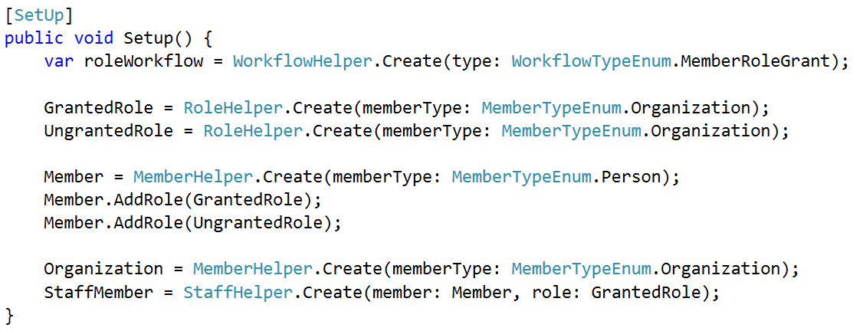
Order brought to chaos
Notes:
Here’s that same chunk of code, cleaned up
Determined many objects were irrelevant – pushed into helpers & used defaults
Still creating a lot of objects, but something that’s manageable
Said it before and I’ll say it again; single most important thing is to build a good helper library

Slide 83
Advanced Techniques – integration tests
Notes:
Until now, in-memory objects only
Eventually, you’re going to want to save your test data to a database so that you can test your data access code, or so that you can automate some of your full-stack system tests.
In this final section, I’ll show you how to use Test Helpers in integration tests

Slide 84
Advanced Techniques – integration tests
Goal: same helpers create data in-memory and in-db
Notes:
It would be really nice if we could use the same Test Helpers to create real data as in-memory data

Slide 85
Advanced Techniques – integration tests
Goal: same helpers create data in-memory and in-db
Challenges:
Foreign keys
Column constraints
Don’t litter database with junk data
Notes:
Easier said than done.
First, you have to deal with foreign keys.
Can’t just new up a Customer and an Order in-memory,
Have to new up entire object graph, save objects to the database in the correct sequence, and then update all the IDs
(This is a little bit easier if you assign primary keys in your application code, but my project uses good old-fashioned autonumber keys)
Second, you have to deal with column constraints.
Non-null columns
Max length
* Lastly, clean up test data when the test run is over.

Slide 86
Advanced Techniques – integration tests
Goal: same helpers create data in-memory and in-db
Challenges:
Foreign keys
Column constraints
Don’t litter database with junk data
Solution: Add a Save() method to Test Helpers
Notes:
These challenges are a pain, but they are manageable with a few extra additions to your Test Helper classes.
The solution we use is to add a Save() method to your Test Helpers
Before I show you how that works, I want to mention a few things
First, this feature assumes you’re using an ORM of some sort. If you’re NOT using an ORM then the concept still applies, but you’ll need to find a different implementation
Second, these code samples are for Nhibernate. You’ll obviously need to modify them to work with Entity Framework or Active Record or whatever you’re using
Let’s look at how the Save method is implemented in my helpers

Slide 87
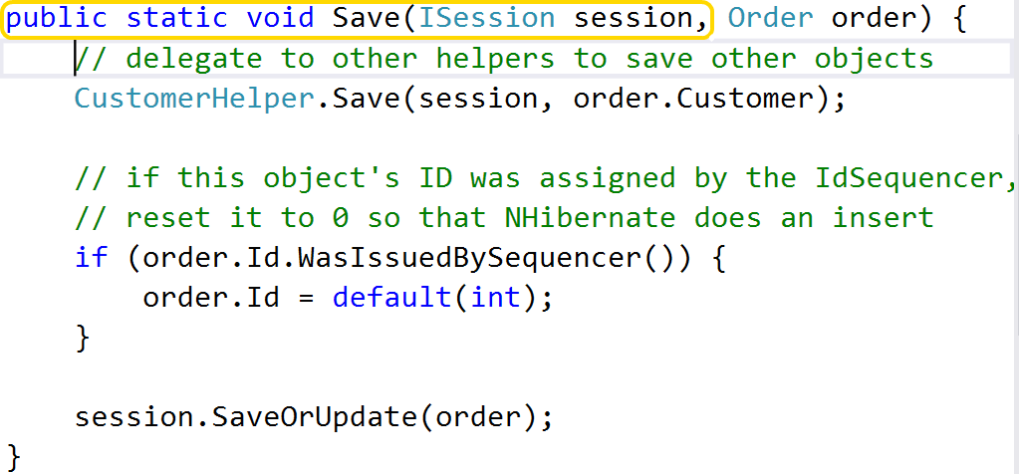
Advanced Techniques – integration tests
Notes:
1st, Save() is static & takes ORM interface as an argument.
It’s certainly possible to use Dependency Injection
All the other helper methods are static – not worth effort for my team

Slide 88
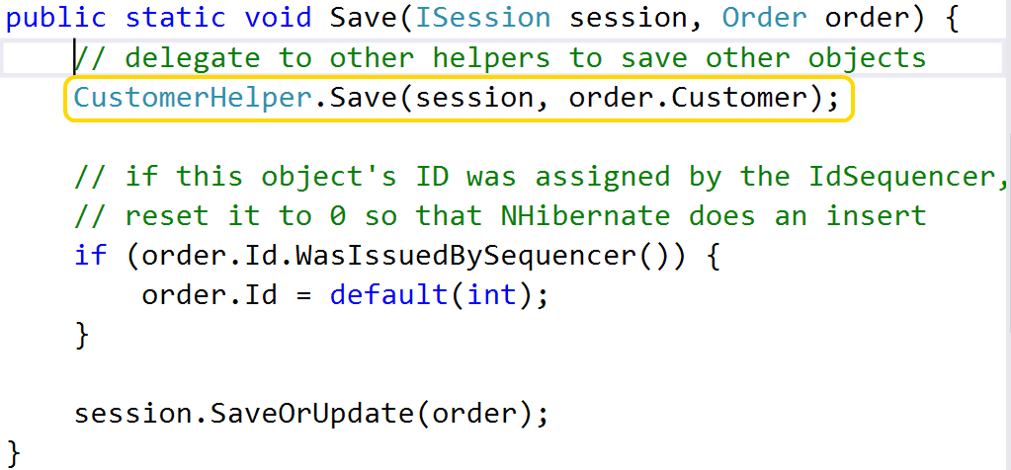
Advanced Techniques – integration tests
Notes:
Next, note that we delegate to other helpers to save any of our dependent objects
Can’t save an Order unless it refers to a valid customer – save the Customer first
Remember, each Test Helper deals w/ one object type only

Slide 89
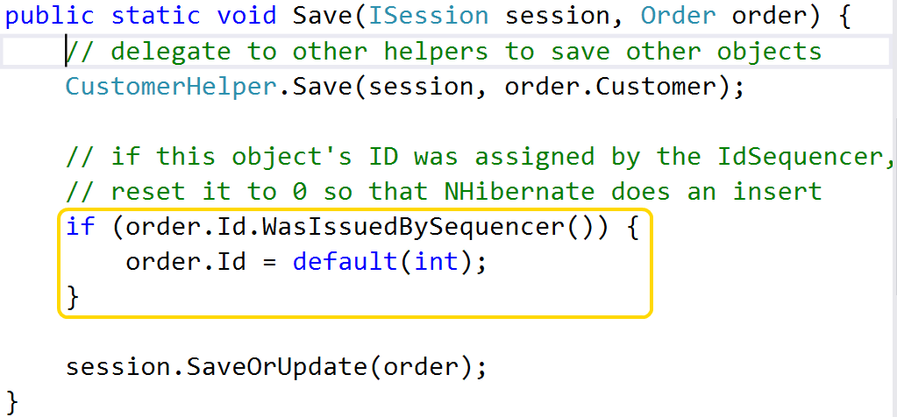
Advanced Techniques – integration tests
Notes:
Third, Save method is responsible for resetting any Id values that were assigned by the IdSequencer to 0
We’re using Nhibernate in this example, and if we tell it to save an object that has a non-zero ID, it will issue an update
Resetting the Id to zero forces it to do an insert, which is what we want
Note that we don’t need to reset ALL values that were assigned by the IdSequencer, only entity IDs

Slide 90
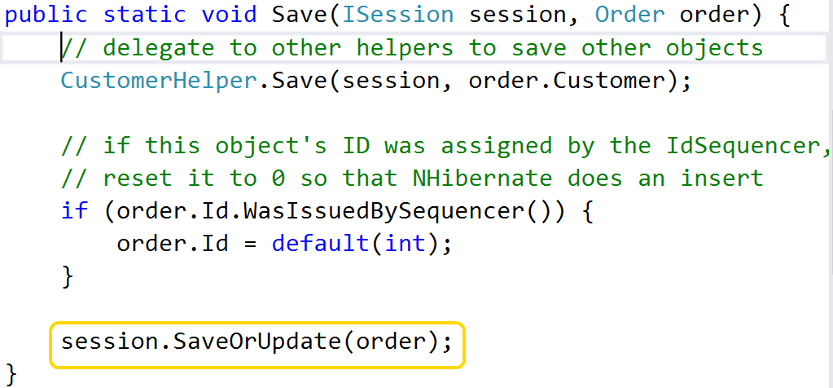
Advanced Techniques – integration tests
Notes:
Finally, we delegate to the ORM to insert or update the object
Each helper should know how to save the objects that it creates
The implementation of your Save methods will be driven by your Create methods –
Does NOT need to handle any arbitrary object, only those configurations created by the helper
Transition
Finally, we need to prevent this test data from lingering around when our test run is over
One possibility is to reset the database to a known state at the start of each test run. This works, but I tend to run my unit tests against the same DB I use for local testing
Don’t want data I’ve crafted by hand from being blown away by tests
Don’t want to lose any schema changes I’ve made

Slide 91
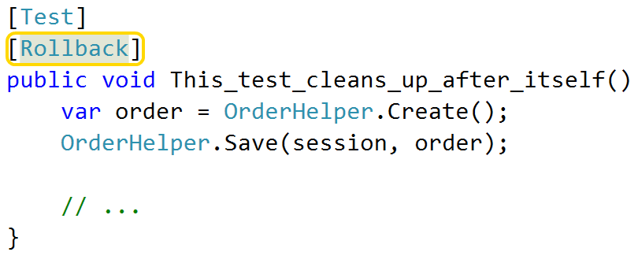
Advanced Techniques – integration tests
[Rollback] attribute
Creates DB transaction when test starts
Rolls back when test ends
Notes:
Another option is to wrap each test run in a database transaction, and then roll back that transaction when the test run is over
This is easy to do by adding an attribute to our data tests. The presence of this attribute automatically executes the test inside of a transaction, and then discards the transaction at the end.

Slide 92
A quick recap…
Good setup code:
Is highly expressive
Highlights what matters / downplays what doesn’t
Doesn’t use inheritance
Is resilient
Notes:
Let’s recap
Good setup code:
Is highly expressive
Highlights what really matters
Avoids inheritance for shared data
Does not require a lot of upkeep

Slide 93
A quick recap…
Good setup code:
Is highly expressive
Highlights what matters / downplays what doesn’t
Doesn’t use inheritance
Is resilient
How?
Short, clean code
Use helpers for object creation
Notes:
And how do we achieve these goals?
Short, clean code
Use helpers for object creation

Slide 94
Parting Words of Wisdom
Hard to test == too complex. Simplify!
Liked what you saw today?
Download materials from github.com/spetryjohnson
Read my blog at petry-johnson.com
Questions / Comments / Suggestions / Flames?
@spetryjohnson
seth@petry-johnson.com
Notes:
I’d like to wrap up with last piece of advice:
CLICK
If something is hard to test, it’s probably too complex.
Don’t be “clever” in your tests – change design to make cleverness unnecessary.
Clean, simple, elegant are the keys to success
CLICK: You can download these materials from my Github account
CLICK: If you have any questions or feedback of any sort, reach me on Twitter or email.
THANK YOU!

